Slide 1




Supabase 101
An introduction to backend development with Supabase

Slide 2


Learning Goals
Build real-time, user-specific prediction logging.
Create a secure Supabase backend.
Perform CRUD operations.
Understand key Supabase and DB terms (Schema, JWT, RLS, CRUD).
Connect Supabase to Python/Streamlit.
Enable Row Level Security (RLS).

Slide 3

Key Glossary Terms
Term | Definition
Schema | Logical namespace in Postgres containing tables and views.
RLS | Restricts row-level access based on user identity.
JWT | JSON Web Token for secure, stateless authentication.
Realtime | WebSocket-based DB change notifications from Supabase.
UUID | Universally unique 128-bit identifier used as primary key.

Slide 4


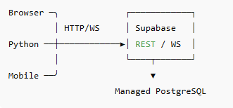

Supabase Architecture
Web, mobile, and Python applications connect seamlessly
Core Services
Postgres DB
Authentication (email, OAuth, JWT)
Realtime channels
Object Storage
Unified access to real-time data and resources
This diagram illustrates how various platforms interact with Supabase services
Supabase empowers developers with powerful backend services

Slide 5


Creating a Supabase Project
Steps
Log in to https://app.supabase.com
Click New Project → Name: smart_energy
Choose closest region (e.g., Singapore)
Set strong DB password
Save Project URL & Anon Key

Slide 6

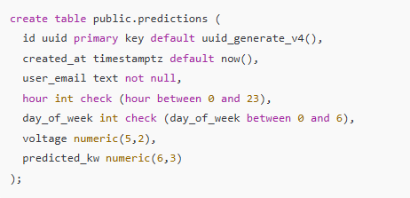
Creating Predictions Table Using SQL

Slide 7

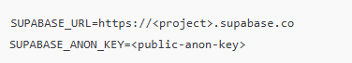
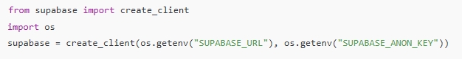
Secrets & SDK Connection
.env File
Python SDK

Slide 8

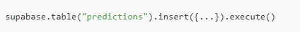
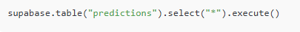
CRUD Operations
Create
Read
Update
Delete

Slide 9

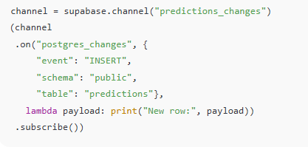
Realtime Subscriptions

Slide 10
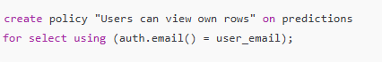
Row Level Security (RLS)
✔️ Ensures users only access their own data.
🔐 Best practice: Always enable RLS in production.

Slide 11
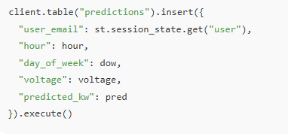
Integration in Streamlit
Example in make_prediction()

Slide 12
Common Errors & Fixes
Error | Likely Cause | Solution
401 Unauthorized | Wrong API Key | Copy again from dashboard
400 Bad Input | Column or data mismatch | Check table schema
Connection Refused | VPN/Firewall issue | Open port 443 or use VPN

Slide 13

Summary
Realtime for responsive dashboards
Streamlit + Supabase = production-ready AI apps
RLS secures user data
Supabase = PostgreSQL + Auth + Realtime
CRUD via Python SDK

Slide 14

Thank you For Listening.

